Slide 1
19CSE202 Database Management Systems Functional Dependency Theory
Slides Courtesy : Abraham Silberschatz, Henry F Korth, S. Sudarshan

Slide 2
Closure of a set of FDs
Clouse set of attributes
Canonical Cover
Lossless Decomposition
Dependency Preservation

Slide 3
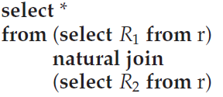

Lossless Decomposition
Let r (R) be a relation schema, and let F be a set of functional dependencies on r (R).
Let R1 and R2 form a decomposition of R.
We say that the decomposition is a lossless decomposition if there is no loss of information by replacing r(R) with two relation schemas r1(R1) and r2(R2).
More precisely, we say the decomposition is lossless if, for all legal database instances (that is, database instances that satisfy the specified functional dependencies and other constraints), relation r contains the same set of tuples as the result of the following SQL query:

Slide 4
Lossy decomposition
A decomposition that is not lossless is lossy decomposition.
Also called as lossless-join decomposition and lossy-join decomposition.
Eg. Decomposing Emp(id, name, street, city, salary) as
1234, Kim, Raja Street, Coimbatore, 20000
2345, Kim, V. H. Road, Chennai, 25000
Emp1(id,name) and Emp2(name, street, city, salary)
(1234, Kim) (Kim, Raja Street, Coimbatore, 20000)
(2345, Kim) (Kim, V. H. Road, Chennai, 25000)
When we do natural join of Employee 1 and Employee 2
1234, Kim, Raja Street, Coimbatore, 20000
1234, Kim, V. H. Road, Chennai, 25000
2345, Kim, Raja Street, Coimbatore, 20000
2345, Kim, V. H. Road, Chennai, 25000

Slide 5
Checking Lossless/Lossy Decomposition
Let r (R) be a relation schema, and let F be a set of functional dependencies on r (R).
Let R1 and R2 form a decomposition of R.
(1) R1 and R2 form a lossless decomposition
of R if at least one of the following functional dependencies is in F⁺:
• R1 ∩ R2 → R1
• R1 ∩ R2 → R2
(2) In other words, if R1 ∩ R2 forms a superkey of either R1 or R2, then the decomposition of R is a lossless decomposition
Using FDs.
instructor (ID, name, dept name, salary)
department (dept name, building, budget)
inst dept (ID, name, salary, dept name, building, budget)
R= ID, name, salary, dept name, building, budget
R1= ID, name, dept name, salary
R2= dept name, building, budget
R1 ∩ R2 = dept_name
dept_name→ dept_name, building, budget, ie., R1 ∩ R2 → R2. This is lossless decomposition

Slide 6
Example,
A relation R (A, B, C, D) with F = {A->BC} is decomposed into R1(ABC) and R2(AD).
This is lossless join decomposition
because Att(R1) ∩ Att(R2) = A is a key of R1(ABC) because A->BC is given.

Slide 7
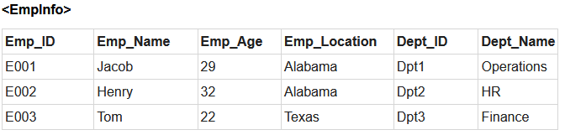
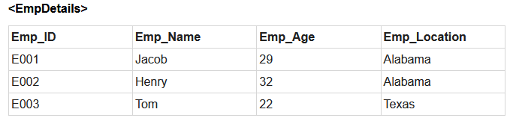
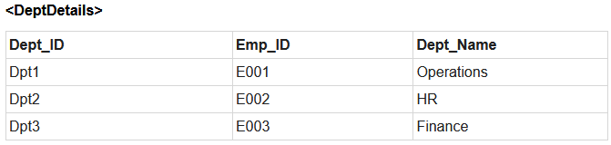
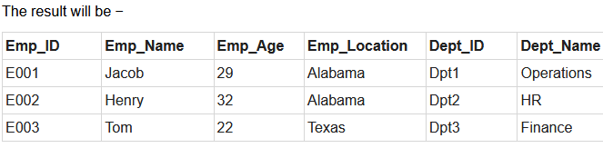
Natural Join is applied on the above two tables −
Therefore, the above relation had lossless decomposition i.e. no loss of information.

Slide 8
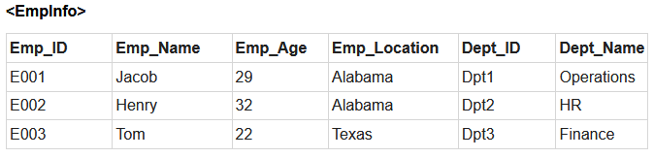
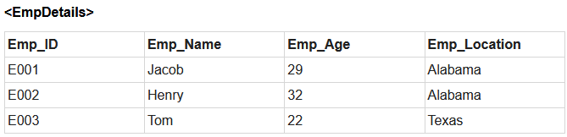
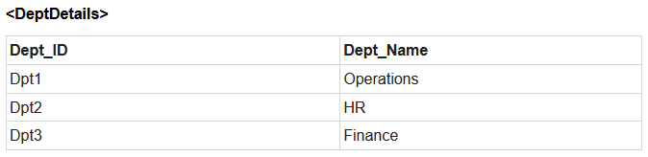
Now, you won’t be able to join the above tables, since Emp_ID isn’t part of the DeptDetails relation.
Therefore, the above relation has lossy decomposition.

Slide 9
Closure of a set of FDs
Clouse set of attributes
Canonical Cover
Lossless Decomposition
Dependency Preservation

Slide 10
Dependency Preservation
Let F be a set of functional dependencies on a schema R, and let R1, R2, . . . , Rn be a decomposition of R.
The restriction of F to Ri is the set Fi of all functional dependencies in F⁺ that include only attributes of Ri .
definition of restriction uses all dependencies in F+, not just those in F
Example r(R) = r(A, B,C)
F = {A→ B, B →C}
F⁺ = {A→ B, B →C, A→C}
Let the decompositions r1(AC) and r2(AB)
Now the restriction of F to r1 is {A→C} and to r2 is {A→B}

Slide 11
Dependency Preservation
Let F be a set of functional dependencies on a schema R, and let R1, R2, . . . , Rn be a decomposition of R
The set of restrictions F1, F2, . . . , Fn is the set of dependencies
Let F¹ = F1 ∪ F2 ∪ ・ ・ ・ ∪ F
(1) in general, F¹ <> F.
(2) However, it may be that F¹⁺ = F ⁺ .
(3) If the latter is true, then every dependency in F is logically implied by F¹.
(4) if we verify that F ¹ is satisfied, we have verified that F is satisfied.
(5) We say that a decomposing having the property F¹⁺ = F ⁺ is a dependency – preserving decomposition.

Slide 12
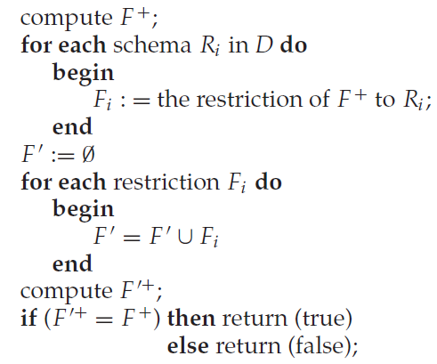
Algorithm for testing Dependency Preservation
The input is a set D = {R1, R2, . . . , Rn} of decomposed relation schemas, and a set F of functional dependencies.

Slide 13
If we decompose a relation R into relations R1 and R2, All dependencies of R either must be a part of R1 or R2 or must be derivable from combination of FD’s of R1 and R2.
For Example,
A relation R (A, B, C, D) with F = {A->BC} is decomposed into R1(ABC) and R2(AD)
is dependency preserving because FD A->BC is a part of R1(ABC).

Slide 14
Examples:
Let R (A, B, C, D) be a relational schema with the following functional dependencies F ={A → B, C → B, C → D and B → D}. The decomposition of R into
(A, B), (B, C), (B, D).
(A) lossless and dependency preserving (B) lossless, not dependency preserving (C) lossy, dependency preserving (D) lossy, not dependency preserving
Dependency preserving or not.
F ={A → B, B → C, C → D and D → B}.
F1={A→B}, F2={C→B}, F3={B→D}.
F¹=F1UF2UF3 = {A→B, C→B, B→D}
We can derive C→D from F¹ by transitivity rule.
So dependency is preserved.
Lossless/lossy.
R1 ∩ R2 ∩ R3 = (AB) ∩ (BC) ∩ (BD) = B
and B→BC ie, B→ R2.. So it is lossless.
Answer (A) lossless, dependency preserving
Suppose, F ={A → B, B → C, C → D and B→D}.
Answer is (B) lossless and not dependency preserving. Why?

Slide 15
Algorithms for Decomposition
Real time database schemas are bigger in size.
We need proper algorithm for decomposition.

Slide 16
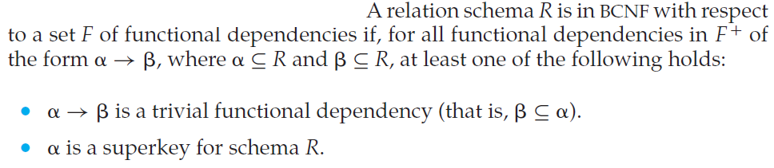
BCNF Decomposition
The definition of BCNF can be used directly to test if a relation is in BCNF.
However, computation of F+ can be a tedious task.
Will discuss simplified tests for verifying if a relation is in BCNF.

Slide 17
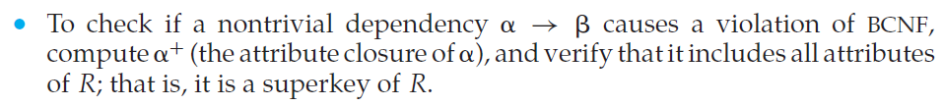


Testing for BCNF
Testing of a relation schema R to see if it satisfies BCNF
Procedure 2 does not work when a relation is decomposed.
That is, it does not suffice to use F when we test a relation Ri , in a decomposition of R, for violation of BCNF.
Eg. R (A, B,C, D, E), F= {A->B, BC->D} and decomposed to R1(A,B) and R2(A,C,D,E)
Now R2 has no fd to test. U may misled to think R2 is in BCNF..
But we can infer AC->D from F (in F+), and by this FD R2 is not in BCNF.
Thus we need F+, not F, to show that a decomposed relation is not in BCNF.

Slide 18
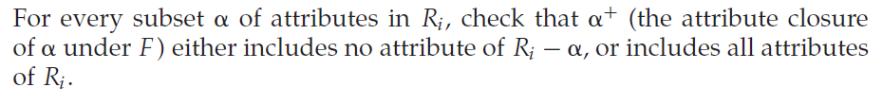

Procedure 3:
To check if a relation Ri in a decomposition of R is in BCNF
If the condition is violated by some set of attributes in Ri , the following functional dependency can be shown to be present in F+:
This shows that Ri violates BCNF.

Slide 19
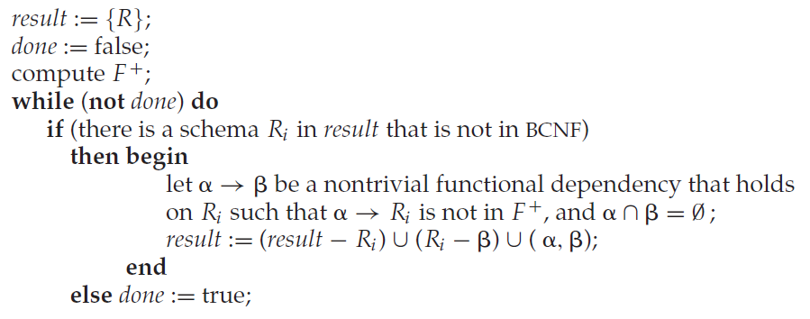
BCNF Decomposition Algorithm
A general method to decompose a relation schema so as to satisfy BCNF.
If R is not in BCNF, we can decompose R into a collection of BCNF schemas R1, R2, . . . , Rn by this algorithm.
The algorithm uses dependencies that demonstrate violation of BCNF to perform the decomposition.

Slide 20
The decomposition that this algorithm generates is not only in BCNF, but is
also a lossless decomposition.
Lossless
• R1 ∩ R2 → R1
• R1 ∩ R2 → R2

Slide 21
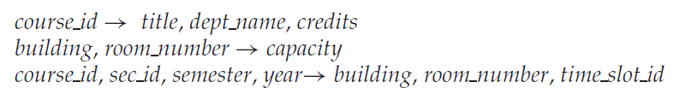
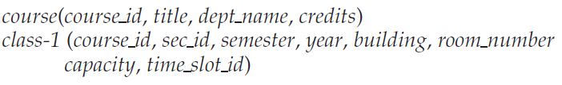
Example
Apply the algorithm
(1) FD1, is non-trivial and LHS is not the key. So Class is not in BCNF. Decompose
Course is in BCNF

Slide 22

FD2 holds in class 1
FD2: non-trivial, LHS is not key. So class-1 is not in BCNF. Decompose
Both classroom and section are in BCNF.
Class is decomposed in to course, classroom and Section.

Slide 23
4NF – with multivalued dependencies
Some relation schemas, even though they are in BCNF, do not seem to be sufficiently normalized, in the sense that they still suffer from the problem of repetition of information.
Consider a variation of the university organization where an instructor may be associated with multiple departments.
inst (ID, dept name, name, street, city)
this is a non-BCNF schema because of the functional dependency
ID→ dept_name, not hold
ID→ name, street, city, holds
and because ID is not a key for inst
Further
assume that an instructor may have several addresses (say, a winter home and a summer home).
“ID→street, city”, not hold “ID → name” holds

Slide 24
4NF – with multivalued dependencies
Instructors belongs to multiple departments and have multiple addresses
inst (ID, dept name, name, street, city)
ID→ dept_name, not hold
“ID→street, city”, not hold
“ID → name” holds
Inst fails in BCNF, by ID→ Name, so decomposition
r1 (ID, name)
r2 (ID, dept name, street, city)
r1 is in BCNF. Why? (holds only ID→name and ID is the key)
r2 is not in BCNF. Why? (no FD holds )

Slide 25
4NF – with multivalued dependencies
r2 (ID, dept name, street, city)
Though r2 is in BCNF, still there is redundancy. How?
For the instructors belong to several department with same address, the address is redundant.
For the instructors belong single department but with different addresses, the dept_name is redundant.
For the instructor belongs to one department and has one address, there is one tuple and no redundant.
We can resolve the redundancy by decomposing
r21(ID, dept_name)
r22(ID, street, city)
However, there is no fd in r2 to proceed to this decomposition.

Slide 26
4NF – with multivalued dependencies
To deal with this problem, we must define a new form of constraint, called a multivalued dependency.
We define a new normal form, called fourth normal form (4NF)
4NF is more restrictive than BCNF.
Every 4NF schema is also in BCNF but there are BCNF schemas that are not in 4NF.

Slide 27
Multivalued dependencies
Functional dependencies rule out certain tuples from being in a relation.
ie., If A → B, then we cannot have two tuples with the same A value but different B values.
Multivalued dependencies, on the other hand, do not rule out the existence of certain tuples. Instead, they require that other tuples of a certain form be present in the relation.
For this reason, functional dependencies sometimes are referred to as equality-generating dependencies, and multivalued dependencies are referred to as tuple-generating dependencies.

Slide 28

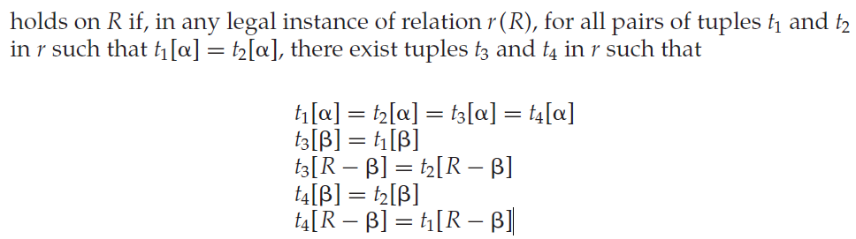
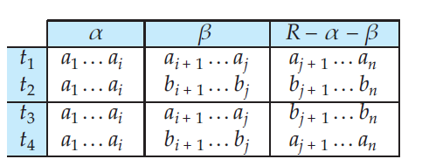
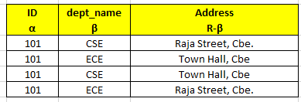

Multivalued dependencies
Recall (fd)
In a relation A→ B means, for any two tuples t1 and t2 if t1[A]=t2[A] then t1[B]= t2[B].
A simple example

Slide 29
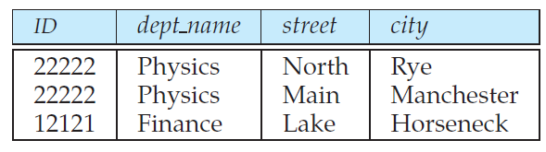
Multivalued dependencies
Example for relation in BCNF with redundancy
This redundancy is unnecessary, because the relationship between the dept_name and ID of an instructor is independent of the relationship between the ID and the address.
So we can specify the multivalued dependencies
Id→→dept_name
id→→street,city

Slide 30
Multivalued dependencies
As with functional dependencies, we shall use multivalued dependencies in two ways:
1. To test relations to determine whether they are legal under a given set of functional and multivalued dependencies.
2. To specify constraints on the set of legal relations; we shall thus concern ourselves with only those relations that satisfy a given set of functional and multivalued dependencies

Slide 31
Multivalued dependencies
Let D denote a set of functional and multivalued dependencies. The closure D+ of D is the set of all functional and multivalued dependencies logically implied by D.
If the multivalued dependency α →→β is satisfied by all relations on schema R, then α →→β is a trivial multivalued dependency on schema R.
α →→ β is trivial if β ⊆ α or α ∪ β = R.

Slide 32
4 NF
A relation schema r (R) is in fourth normal form (4NF) with respect to a set D of functional and multivalued dependencies if, for all multivalued dependencies in D+ of the form α→→β, where α ⊆ R and β ⊆ R, at least one of the following holds:
• α →→ β is a trivial multivalued dependency.
• α is a superkey for R.
definition of 4NF differs from the definition of BCNF in only the use of multivalued dependencies.
A database design is in 4NF if each member of the set of relation schemas that constitutes the design is in 4NF.

Slide 33
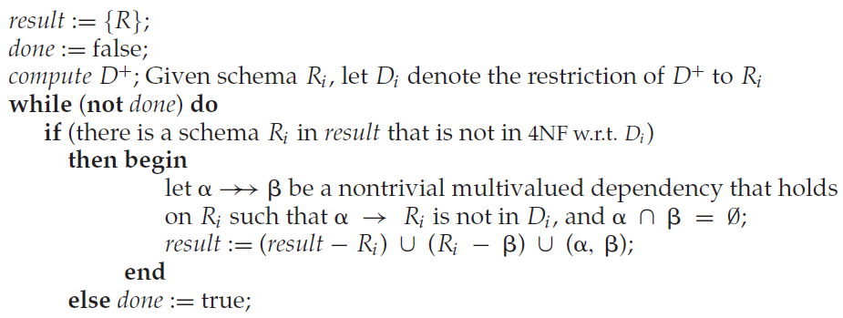
4 NF Decomposition
Example:
r2 (ID, dept name, street, city)
mds: Id→→dept_name, id→→street,city
Id→→dept_name: Non-trivial and Id is not key. So decompose
r21(ID, dept_name)
r22(ID, street, city)

Slide 34
Let r (R) be a relation schema, and let D be a set of functional and multivalued dependencies on R. Let r1(R1) and r2(R2) form a decomposition of R. This decomposition is lossless of R if and only if at least one of the following multivalued dependencies is in D+:
R1 ∩ R2 →→ R1
R1 ∩ R2 →→ R2
The issue of dependency preservation when we decompose a relation schema becomes more complicated in the presence of multivalued dependencies.

Slide 35
Higher Normal forms
There are types of constraints called join dependencies that generalize multivalued dependencies, and lead to another normal form called project-join normal form (PJNF) (PJNF is called fifth normal form in some books).
There is a class of even more general constraints that leads to a normal form called domain-key normal form (DKNF).

